Slide 1
Data, Environment and Society Lecture 5: Merge, Groupby and Pivot
September 12, 2019
Instructor: Duncan Calllaway
GSI: Salma Elmallah

Slide 2
Announcements
Group project
Form teams and pose prediction question by October 3
Start thinking about project ideas and team members (groups need to be 2-3 people)
There will be a few questions on your HW5 to get you working with the data (due Oct 10).
Late policy:
Homework submitted late will not be graded
You may request a two day extension twice in the semester
Coordinate through Salma
HW 1 due today, HW2 due Thursday.
Bring laptops to lecture next Tuesday; always bring laptops to lab.

Slide 3
Reading
Hino et al, "Machine learning for environmental monitoring," *Nature Sustainability* (2018).
Pelletier et al "Predicting plant conservation priorities on a global scale", *PNAS* (2018).
You don't need to understand the details of the methods, but rather the framing, problem being solved, and conclusions. Questions to focus on:
What is the prediction question? Are the authors making predictions across space, time, or some other dimension?
What is the key policy application?
Name two or more factors readers should take into consideration as they interpret and implement the results.
These could relate to error propogation, causal inference or other factors.

Slide 4
Follow up thoughts on prediction vs inference
Some students argued after class that prediction questions should remove any “due to” type statements:
“how will solar adoption change in the future”
Others argue that we should include a list of covariates in our statement of the prediction problem
“how will solar adoption change in the future, when drive the prediction model with a range of features including policy incentives, household income and energy costs.”
In any case “due to” or “as a consequence of” language needs to be scrubbed from prediction question statements.

Slide 5
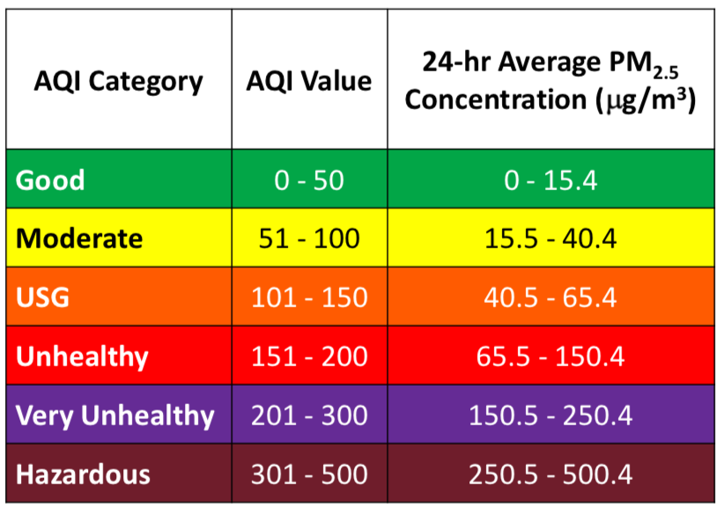
How do we measure PM2.5 concentrations?
Two options:
Raw measurement: micrograms per cubic meter
AQI: scaled version of the same measure
Where do you think the AQI scale comes from?
EPA bureaucrats take recommendations from “Clean Air Scientific Advisory Committee”
Science on the topic does not have significant causal support
Source: epa.gov
Notes:
Though there is no strong causal support for the AQI values, are they still meaningless or not useful?

Slide 6
Today…
How to put data frames together, reshape them to synthesize information?
We’ll answer this with some really useful Pandas functions:
Merge
Groupby
Pivot
A few things to take away
Debugging these commands takes patience and a critical eye.
Groupby and Pivot enable aggregation of data without explicit use of logical indexing.

Slide 7
Merge
(following slides borrowed from DS100 notes)

Slide 8
Joining two tables
OrderNum | ProdID | Name
1 | 42 | Gum
2 | 999 | NullFood
2 | 42 | Towel
OrderId | Cust Name | Date
1 | Joe | 8/21/2017
2 | Arthur | 8/14/2017
x
Left “key”
Right “key”
OrderNum | ProdID | Name | OrderId | Cust Name | Date
1 | 42 | Gum | 1 | Joe | 8/21/2017
1 | 42 | Gum | 2 | Arthur | 8/14/2017
2 | 999 | NullFood | 1 | Joe | 8/21/2017
2 | 999 | NullFood | 2 | Arthur | 8/14/2017
2 | 42 | Towel | 1 | Joe | 8/21/2017
2 | 42 | Towel | 2 | Arthur | 8/14/2017
Drop rows that don’t match on the key

Slide 9
Joining two tables
OrderNum | ProdID | Name
1 | 42 | Gum
2 | 999 | NullFood
2 | 42 | Towel
OrderId | Cust Name | Date
1 | Joe | 8/21/2017
2 | Arthur | 8/14/2017
x
Left “key”
Right “key”
OrderNum | ProdID | Name | OrderId | Cust Name | Date
1 | 42 | Gum | 1 | Joe | 8/21/2017
1 | 42 | Gum | 2 | Arthur | 8/14/2017
2 | 999 | NullFood | 1 | Joe | 8/21/2017
2 | 999 | NullFood | 2 | Arthur | 8/14/2017
2 | 42 | Towel | 1 | Joe | 8/21/2017
2 | 42 | Towel | 2 | Arthur | 8/14/2017
Drop rows that don’t match on the key
OrderNum | ProdID | Name | OrderId | Cust Name | Date
1 | 42 | Gum | 1 | Joe | 8/21/2017
2 | 999 | NullFood | 2 | Arthur | 8/14/2017
2 | 42 | Towel | 2 | Arthur | 8/14/2017
Notes:
Note this type of merge is an “inner” merge. Later in the course we’ll talk about outer, left, and right merges.

Slide 10
Groupby

Slide 11
Manipulating Granularity: Group By
Key
Data
A
A
3
3
B
B
1
1
C
C
4
4
A
A
1
1
B
B
5
5
C
C
9
9
A
A
2
2
B
B
6
6
C
C
5
5

Slide 12
Manipulating Granularity: Group By
Key
Data
A
3
A
3
A
1
B
B
1
1
A
2
C
C
4
4
A
1
B
B
5
5
C
C
9
9
A
2
B
B
6
6
C
C
5
5

Slide 13
Manipulating Granularity: Group By
Key
Data
A
3
A
3
A
1
B
1
A
2
C
4
A
1
B
1
Split into
Groups
B
5
B
5
C
9
B
6
A
2
C
4
B
6
C
9
C
5
C
5

Slide 14
Manipulating Granularity: Group By
Key
Data
A
3
A
3
Aggregate
Function
A
A
6
A
1
6
B
1
A
2
C
4
A
1
B
1
Split into
Groups
Aggregate
Function
B
B
12
B
5
B
5
12
C
9
B
6
A
2
C
4
B
6
Aggregate
Function
C
9
C
C
18
18
C
5
C
5

Slide 15
Manipulating Granularity: Group By
Key
Data
A
3
A
3
A
1
Aggregate
Function
A
6
B
1
A
2
C
4
A
6
A
1
B
1
Split into
Groups
Put Results
in DataFrame
B
12
B
5
B
5
Aggregate
Function
B
12
C
18
C
9
B
6
A
2
C
4
B
6
Aggregate
Function
C
9
C
18
C
5
C
5

Slide 16
Pivot

Slide 17
Manipulating Granularity: Pivot
Key R
Key
C
Data
A
A
U
U
3
3
B
B
V
V
1
1
C
C
U
U
4
4
A
A
V
V
1
1
B
B
U
U
5
5
C
C
V
V
9
9
A
A
U
U
2
2
B
B
V
V
6
6
D
D
U
U
5
5

Slide 18
Manipulating Granularity: Pivot
Key R
Key
C
A
U
3
Data
Aggregate
Function
A
U
5
A
U
3
A
U
2
B
V
1
Aggregate
Function
A
V
1
A
V
1
C
U
4
Aggregate
Function
B
U
5
B
U
5
A
V
1
Split into
Groups
B
V
1
Aggregate
Function
B
V
7
B
U
5
B
V
6
C
V
9
C
U
4
Aggregate
Function
C
U
4
A
U
2
C
V
9
Aggregate
Function
C
V
9
B
V
6
D
U
5
D
U
5
Aggregate
Function
D
U
5

Slide 19
Manipulating Granularity: Pivot
Key R
Key
C
A
U
3
Data
Aggregate
Function
A
U
5
A
U
5
A
U
3
A
U
2
B
V
1
Aggregate
Function
A
V
1
A
V
1
A
V
1
C
U
4
Aggregate
Function
B
U
5
B
U
5
B
U
5
A
V
1
Split into
Groups
B
V
1
Aggregate
Function
B
V
7
B
U
5
B
V
7
B
V
6
C
V
9
C
U
4
Aggregate
Function
C
U
4
C
U
4
A
U
2
Aggregate
Function
C
V
9
B
V
6
C
V
9
C
V
9
D
U
5
D
U
5
Aggregate
Function
D
U
5
D
U
5

Slide 20
Manipulating Granularity: Pivot
Key R
Key
C
A
U
3
Data
Aggregate
Function
A
U
5
A
U
3
A
U
2
B
V
1
Aggregate
Function
A
V
1
A
V
1
V
U
V
C
U
4
Aggregate
Function
B
U
5
B
U
5
U
A
1
A
5
A
V
1
Split into
Groups
B
V
1
Aggregate
Function
B
V
7
B
5
7
B
U
5
V
B
V
6
C
V
9
C
4
9
C
U
4
Aggregate
Function
C
U
4
U
D
5
A
U
2
Need to address missing values
Aggregate
Function
C
V
9
B
V
6
C
V
9
V
D
U
5
D
U
5
Aggregate
Function
D
U
5
U

